Slide 1
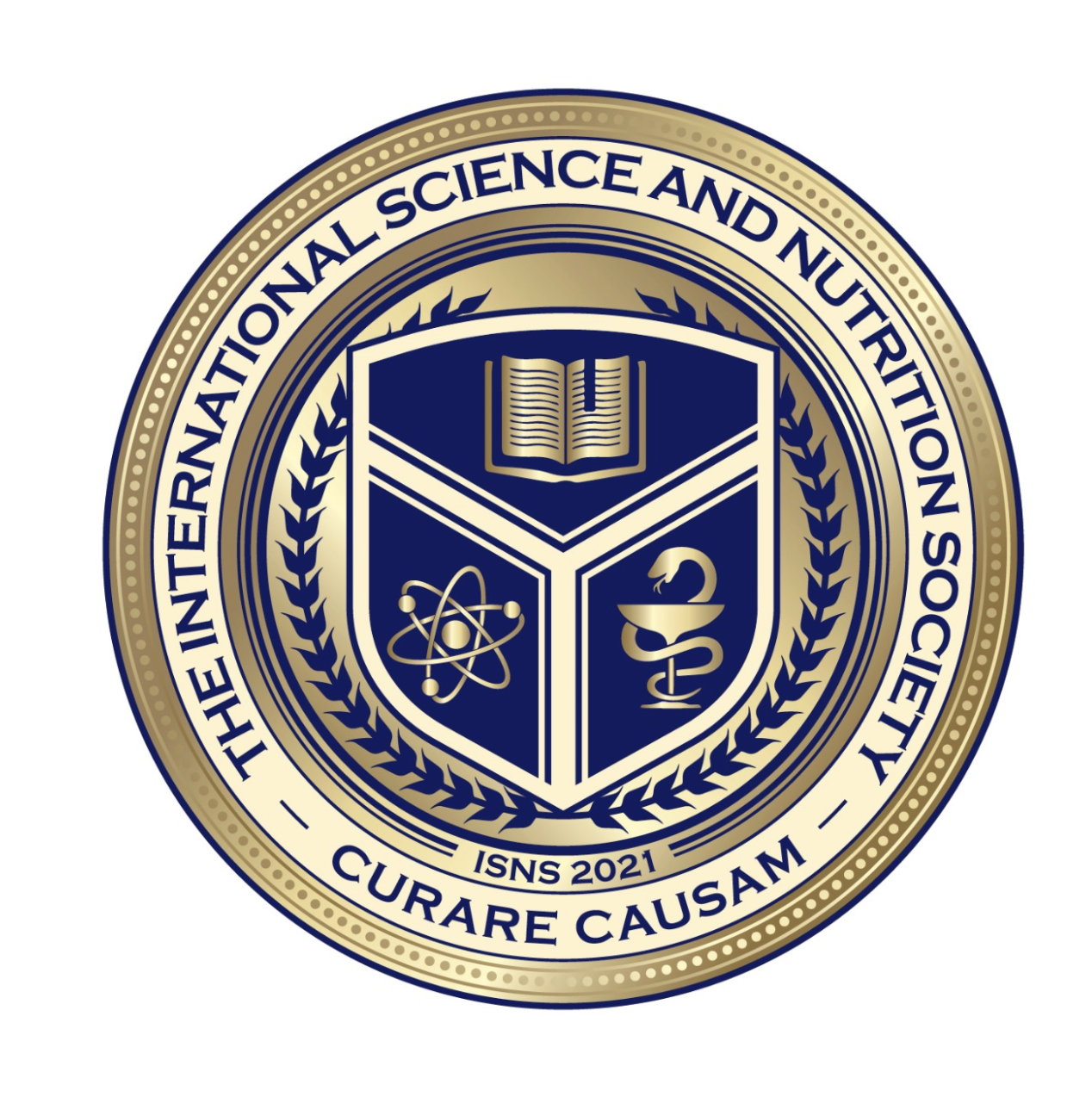
Science with Dr. Christina Rahm We will get started shortly.

Slide 2
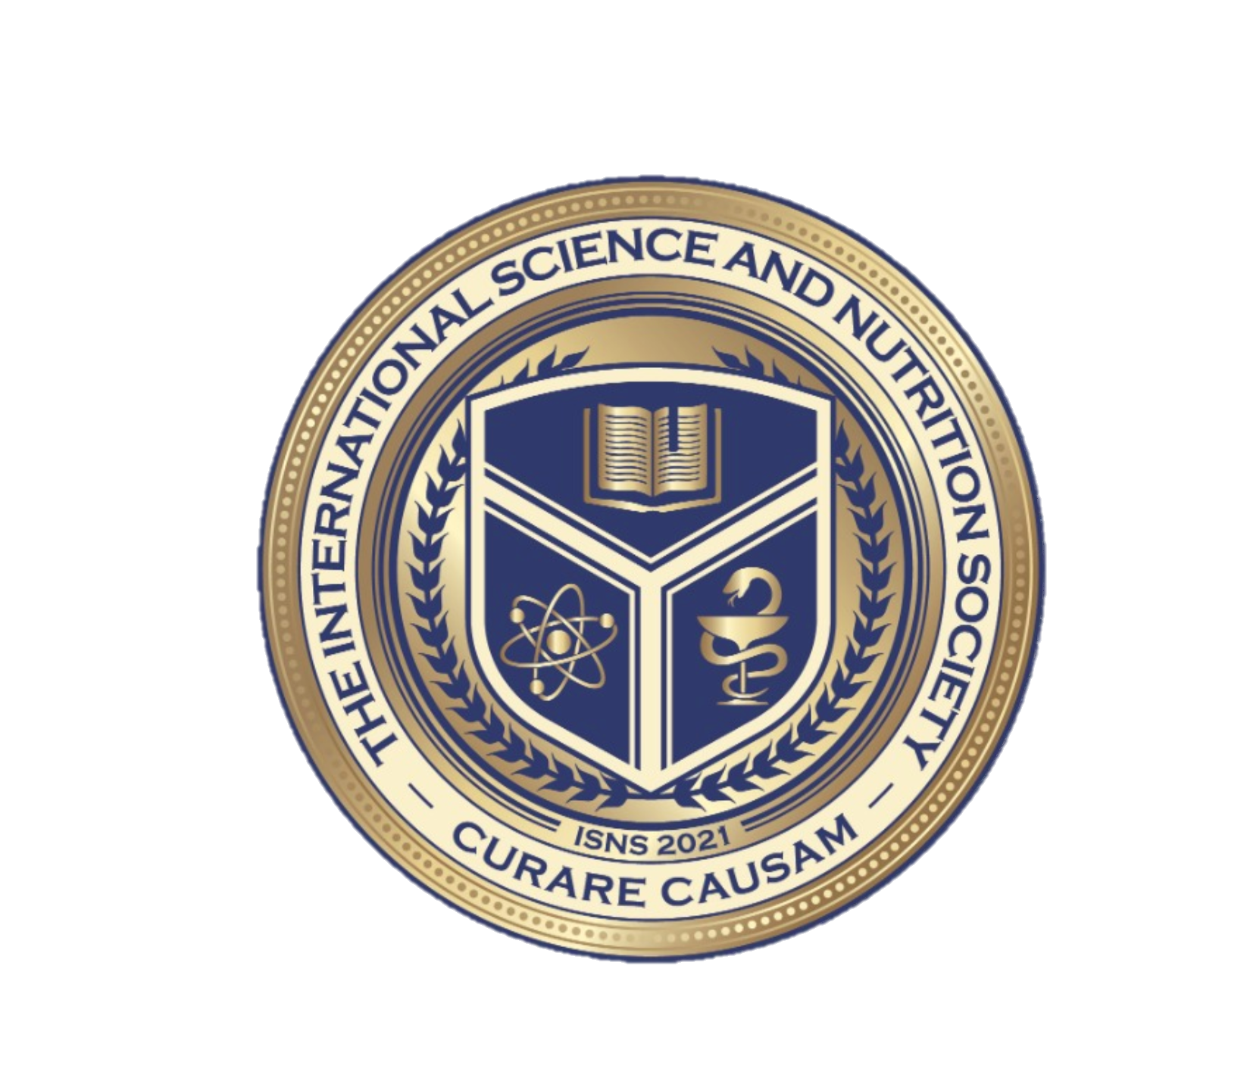
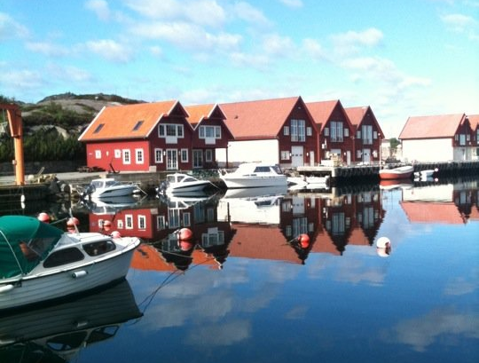
Dr. Dori Naerbo, Ph.D.
Notes:
Good morning, good afternoon, good evening…wherever you are in the world this is Dr. Dori Naerbo and I am your host on today’s call. For those of you who do not know me…I am a clinical researcher and author of several books.

Slide 3
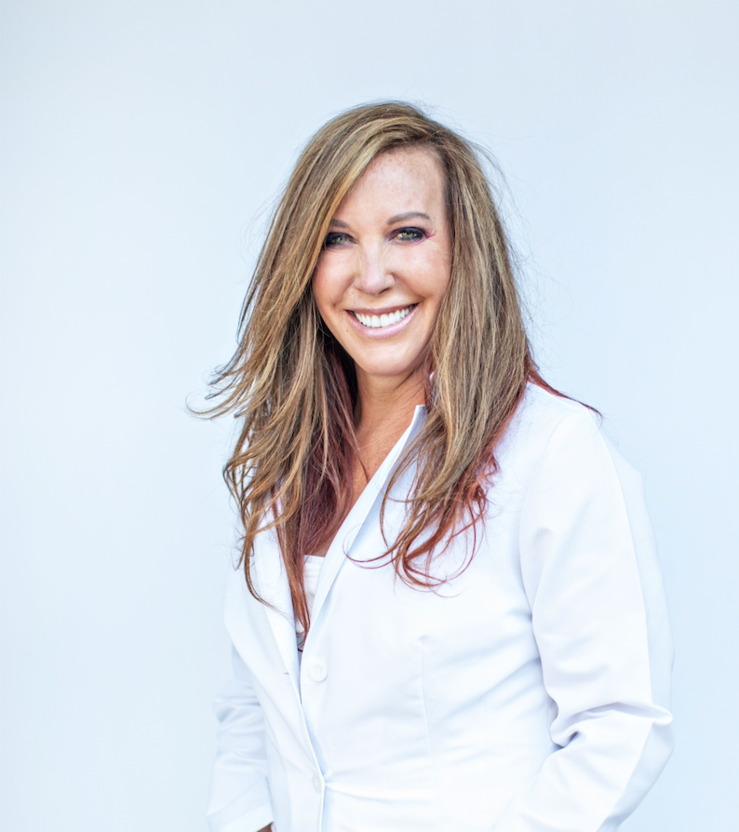
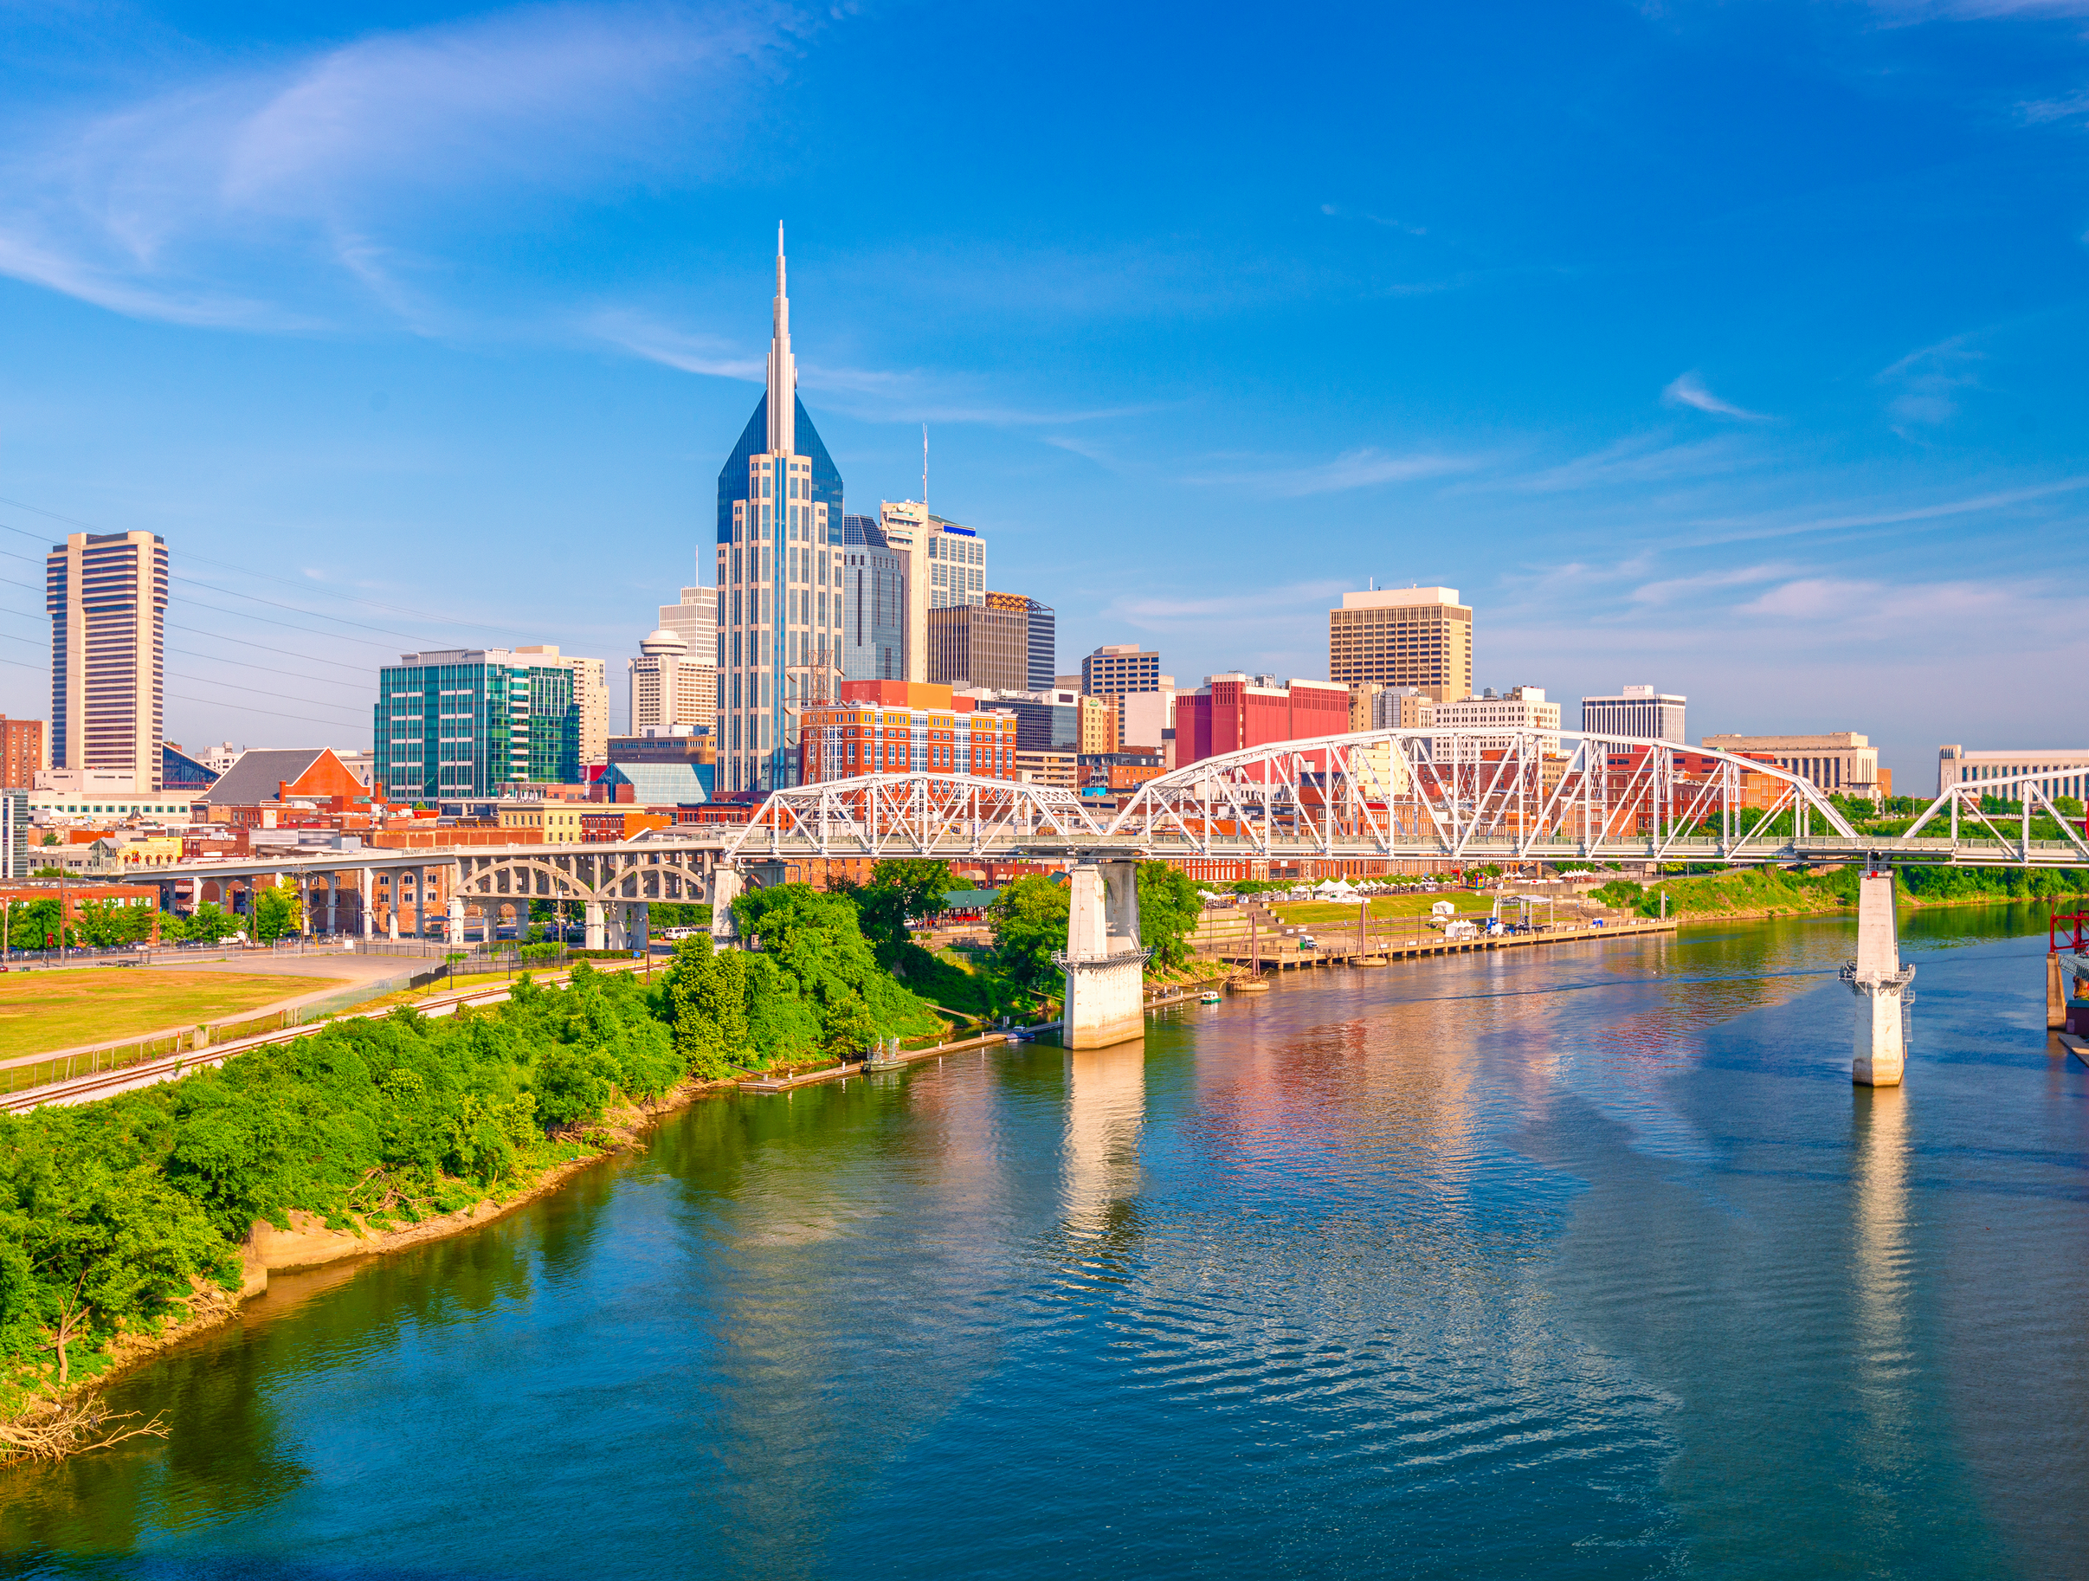
Dr. Christina Rahm CEO & Chief Science Officer

Slide 5
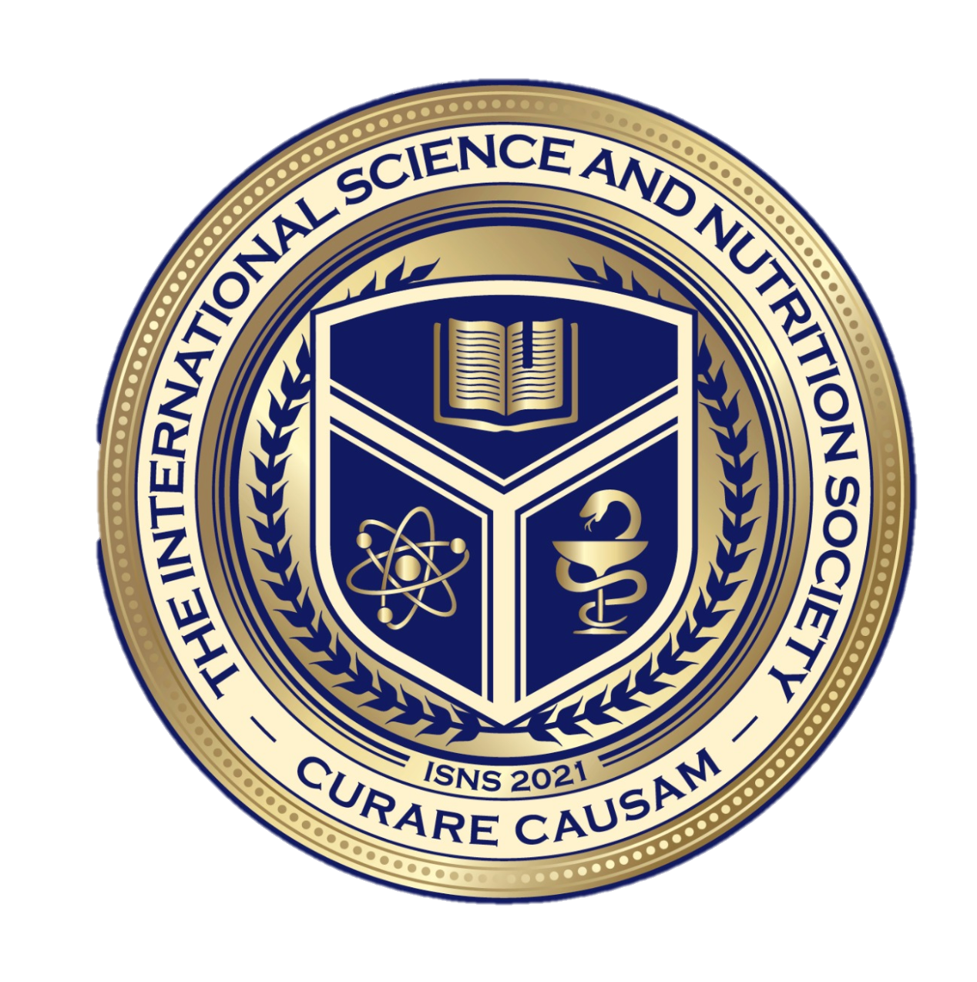
Medical Disclaimer:
The information provided is for educational purposes and is not intended as medical advice, or a substitute for the medical advice of a physician or other qualified health care professional. This is for science and educational purposes only and cannot be used in any aspect for sales or marketing. You should not use this information for diagnosing a health or fitness problem or disease. You should always consult with a doctor or other health care professional for medical advice or information about diagnosis and treatment. This is Confidential. Do not distribute—for scientific educational purposes only.
Notes:
The information provided is for educational purposes and is not intended as medical advice, or a substitute for the medical advice of a physician or other qualified health care professional. This is for science and educational purposes only and cannot be used in any aspect for sales or marketing. You should not use this information for diagnosing a health or fitness problem or disease. You should always consult with a doctor or other health care professional for medical advice or information about diagnosis and treatment. This is Confidential. Do not distribute—for scientific educational purposes only.

Slide 6
ISNS Case Study Presented by: Dr. Norbert Ketskés

Slide 7
STROKE
Stroke is the second leading cause of death and a significant cause of disability worldwide, and the fifth leading cause of death in the United States. In fact, nearly 800,000 people have a stroke each year. That equates to around one person every 40 seconds.
There are three main types of stroke:
Ischemic stroke: This is the most common type of stroke, making up 87% of all cases. A blood clot prevents blood and oxygen from reaching an area of the brain.
Hemorrhagic stroke: This occurs when a blood vessel ruptures. These are usually the result of aneurysms or arteriovenous malformations (AVMs)Trusted Source.
Transient ischemic attack (TIA): This occurs when blood flow to a part of the brain is inadequate for a brief period of time. Normal blood flow resumes after a short amount of time, and the symptoms resolve without treatment. Some people call this a ministroke.

Slide 8
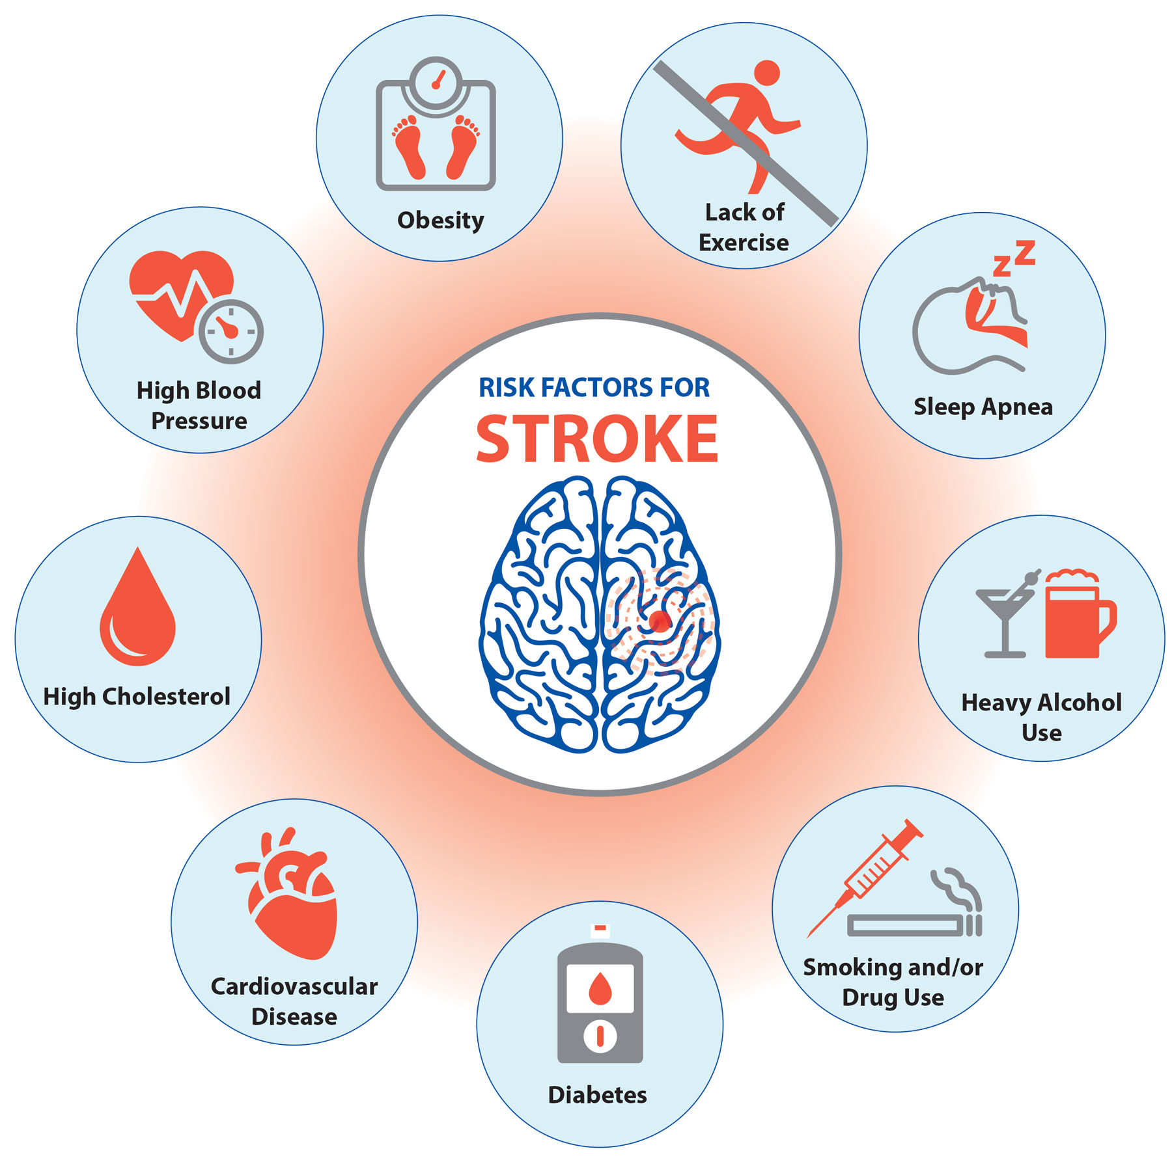
RISK FACTORS
A stroke occurs when a blockage or bleed of the blood vessels either interrupts or reduces the supply of blood to the brain. When this happens, the brain does not receive enough oxygen or nutrients, and brain cells start to die.
Stroke is a disease. This means that it affects cerebrovascular blood vessels that feed the brain oxygen. If the brain does not receive enough oxygen, damage may start to occur.
This is a medical emergency. Although many strokes are treatable, some can lead to disability or death.

Slide 9
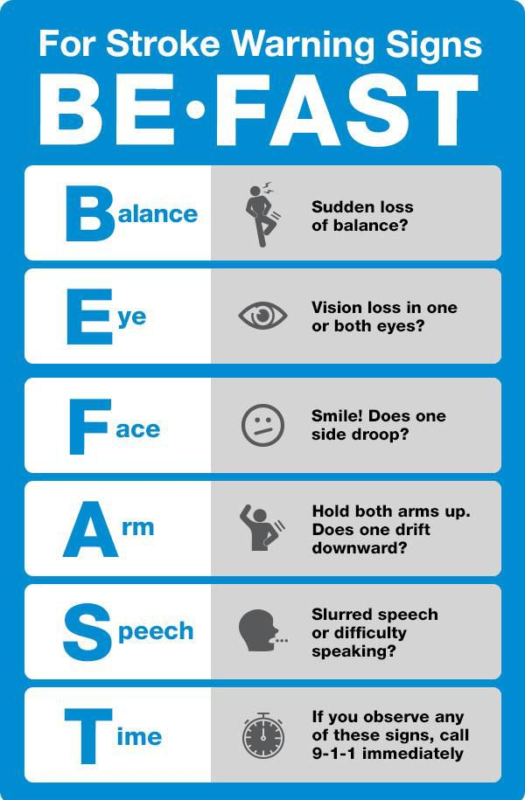
SYMPTOMS
• Sudden numbness of the face, arms, or legs, usually on one side
• Numbness of one half of the body (a definite line can be drawn between the numbing and non-numbing half of the body)
• Weakness or paralysis of one side of the limbs
• Sudden onset of speech, word finding or voice problems (aphasia)
• Sudden blurring of vision (even until blindness), double vision, or rapid decrease in visual acuity
• Sudden dizziness, loss of balance, movement problems
• Unusual, severe headaches of an unusual nature
• Confusion, memory impairment, spatial orientation, or perceptual impairment

Slide 10
PROPRIETARY BLENDS LEGEND
Proprietary blend I: Silica, Vitamin C, and Trace Minerals
Proprietary blend II: N-acetyl L-tyrosine, Anhydrous Caffeine, L-theanine, Velvet Bean Seed, Pine Bark, Curcumin, and Vitamin D
Proprietary blend III: Black seed oil, Resveratrol, turmeric, Raspberry Ketones, Apple Cider Vinegar, Aloe Vera, and D-Ribose
International Science and Nutrition Society – CURARE CAUSAM – ISNS 2021

Slide 11
ISNS CASE STUDY 1: STROKE
Patient: Male
Age: 62-year-old
History: Hypertension 18 years and type 2 diabetes for 3 years. Smoking (20 pcs per day)
Medications: taken regularly: 10 mg amlodipine and 1000 mg metformin.
Symptoms: At our first consultation, he was diagnosed with an ischemic stroke 2 weeks earlier, his left hand and legs were difficult to move, he used a walking frame, he spoke with difficulty, he got tired quickly.

Slide 12
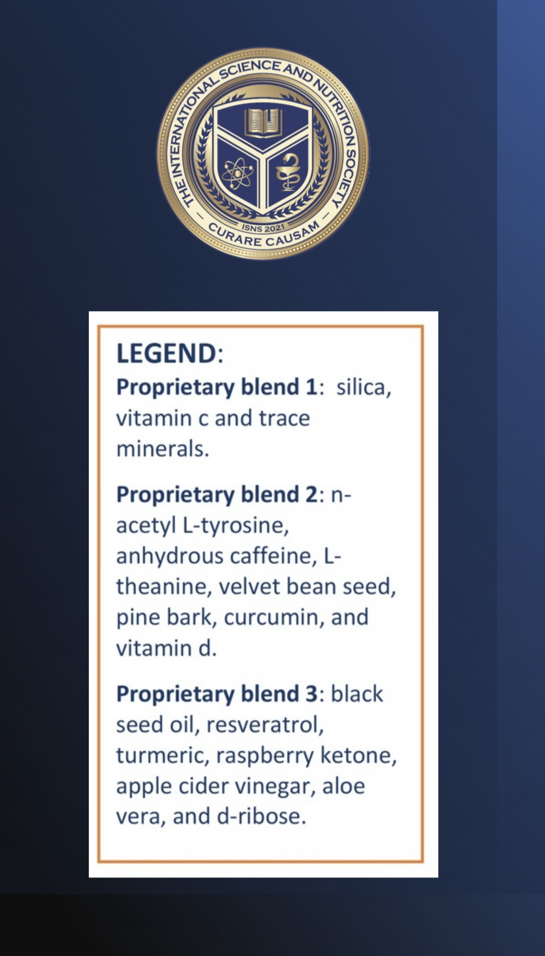
THERAPY
Proprietary blend I : 2x6 drops, morning and evening, for 3 days, then every 3 days then increased by 1-1 drops every 3 days to 2x10
Proprietary blend II : 1 in the morning for 7 days, then 2 daily for 7 days, then 3, 2 in the morning and 1 in the afternoon
Proprietary blend III : 1 in the morning for 7 days, then 1.5 daily for 7 days, then 2, 1 in the morning and 1 in the afternoon

Slide 13
RESULTS
After 1 month, the weakness of his arms and legs gradually decreased, he changed the walking frame to a stick, his speech became more fluent, and he felt stronger.
1
One month later, his arm and leg weakness was minimal, he used only a lighter stick, his speech returned almost normal, and he became stronger both mentally and physically.
2

Slide 14
ISNS ACUTE
CASE STUDY 2: STROKE
Patient: Female
Age: 69-year-old
History: Ischemic stroke with paralysis on right side of her body. She was hospitalized within a few hours and received the proper treatment. Her family called Dr. Ketskés for consultation and advice.

Slide 15
THERAPY
Proprietary blend I: 5 drops, at every 6 hours
Proprietary blend II: 1 at every 6 hours
Proprietary blend III: 1 at every 6 hours

Slide 16
RESULTS – ACUTE CASE
After taking the proprietary blends I, II, and II for 24 hours, she felt significantly better compared to the other 3 roommates diagnosed with the same measures of stroke.
1
They received the same traditional treatment – without the proprietary blends - but still couldn’t move and could not get out of their beds at all, whereas this patient was able to walk around and be of assistance to the other patients.
2

Slide 17
Nutrition for brain recovery after ischemic stroke: an added value to rehabilitation Roberto Aquilani , Paolo Sessarego, Paolo Iadarola, Annalisa Barbieri, Federica Boschi
In clinical studies on rehabilitation patients designed to study the effects of counteracting or limiting this reduction of protein synthesis by providing protein supplementation, patients receiving nutritional supplementation had enhanced recovery of neurocognitive function.
Some studies have documented that nutrition supplementation with B-group vitamins may mitigate oxidative damage after acute ischemic stroke.
In clinical practice, patients with ischemic stroke were found to have a lower than recommended dietary intake of zinc. Patients in whom daily zinc intake was normalized had better recovery of neurological deficits than subjects given a placebo.
https://pubmed.ncbi.nlm.nih.gov/21586419/

Slide 18
Amino acids in post-stroke rehabilitation Dhanasekar Karukkupalayam Ramasamy, Trayambak Dutta, Vellaichamy Kannan, Venkatraman Chandramouleeswaran
Patients with stroke are prone to disability due to muscle hypercatabolism; in this review, researchers reviewed the benefits of amino acids in post-stroke rehabilitation
Amino acids prevent muscle hypercatabolism in post stroke patients by suppressing myofibrillar protein and skeletal muscle degradation
Stroke patients supplemented with amino acids led to an improvement of functional and physical performance
Its supplementation prevents muscle wasting and improves rehabilitation by promoting physical performance, muscle strength, mass, and function
https://pubmed.ncbi.nlm.nih.gov/31328694/

Slide 19
Neuroprotective effects of sonochemical- synthesized silica nanoparticles in vivo models of ischemic/reperfusion injury in stroke Chengcheng Cui, Dayong Shen, Dandan Zuo, and Xinchun Ye
In this study, 500 mg/kg silica nanoparticles showed significant effects on remission of behavioral impairment in rats
Pretreatment of ischemic rats with SiO2 NPs decreased the elevated levels of MDA, TNFα, MCP-1, IL-1β, phosphor Ik-кB, and NO levels
Decreased protein level of NF-κB also measured in SiO2 NPs-treated animals
SiO2 NPs reduced the damage caused by cerebral ischemia/reperfusion in rats and its molecular mechanism attributed to the downregulation of NF-κB signaling pathway
https://www.sciencedirect.com/science/article/pii/S1878535221004317

Slide 20
References
https://www.mayoclinic.org/diseases-conditions/stroke/symptoms-causes/syc-20350113
https://www.cdc.gov/stroke/types_of_stroke.htm
https://www.thieme-connect.com/products/ejournals/abstract/10.1055/s-2008-1040896
https://www.ncbi.nlm.nih.gov/pmc/articles/PMC8399756/
https://pubmed.ncbi.nlm.nih.gov/31328694/
https://www.sciencedirect.com/science/article/pii/S1878535221004317

Slide 21
Thank you for joining us today!

